Slide 1
Master Thesis
Semantic Segmentation of Land Use with High-Resolution Orthophotos and Convolutional Neural Networks
Faculty of Mathematics and Computer Science
Karsten Köhler, Student ID No. 8690570

Slide 2
Content
Image Segmentation
Vegetation Analysis
Literature Review
Convolutional Neural Network
Reference Architectures
Dataset
Raster Preprocessing
Label Preparation
Experiments
Implementation
Metrics
Segmentation Results
Discussion
Literature Review
Spectral Vegetation Indices
Experiments
Implementation
Visualizations
Discussion

Slide 3
Research Question
Background: Emergency Landing Assistant, Emergency Landing Field Identification
Primary Objective: Semantic Segmentation of Land Use
Side Objective: Vegetation Density Analysis

Slide 4
Convolutional Neural Networks
Subset of Neural Networks
Highly efficient on grid-like data like e. g. images
Two common operations:
Convolution
Pooling

Slide 5
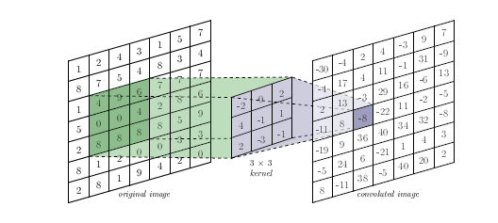
Convolution

Slide 6
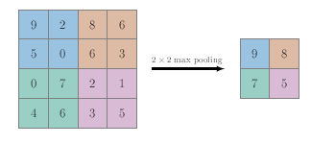
Pooling

Slide 7
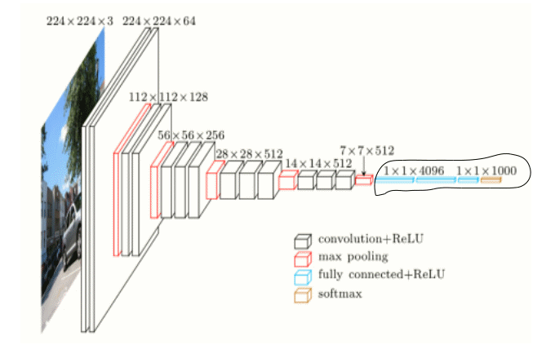
Example CNN Architecture

Slide 8
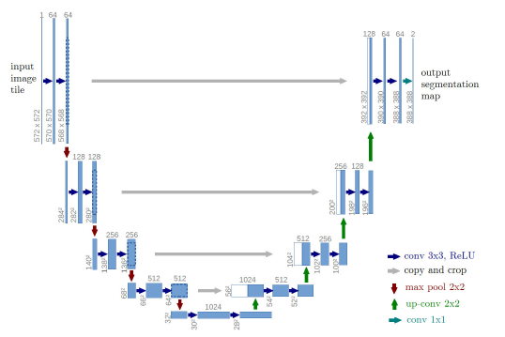
U-Net Architecture

Slide 9
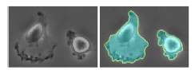
U-Net Metrics

Slide 10
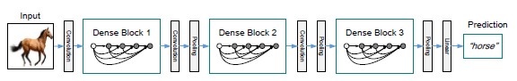
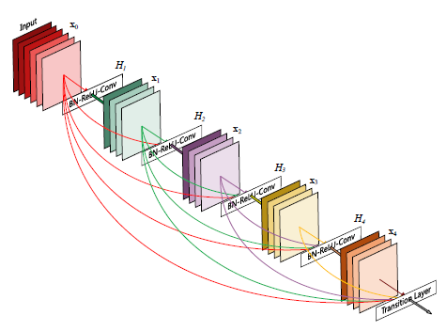
DenseNet Architecture

Slide 11
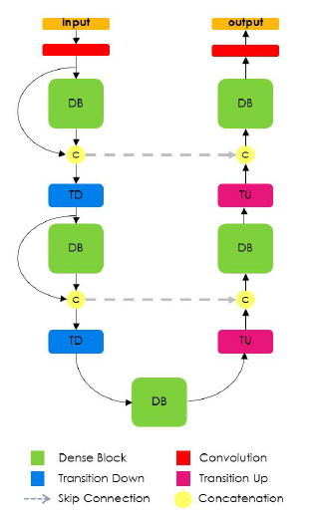
FC-DenseNet Architecture

Slide 12
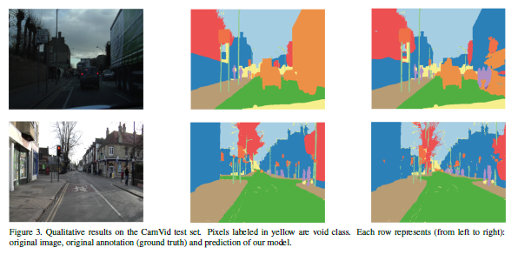
FC-DenseNet Metrics

Slide 13
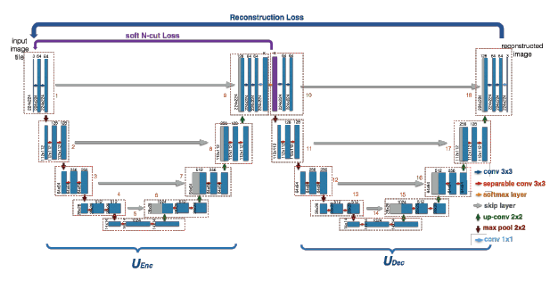
W-Net Architecture

Slide 14
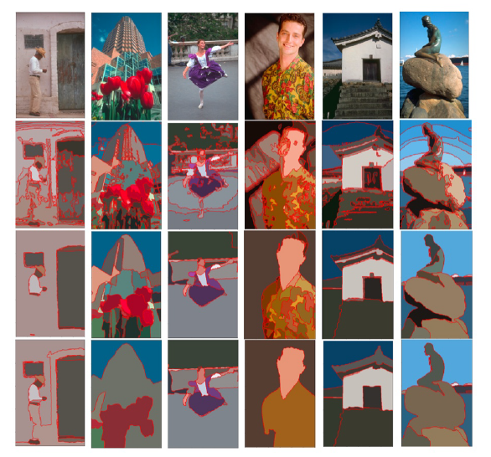
W-Net Metrics

Slide 15
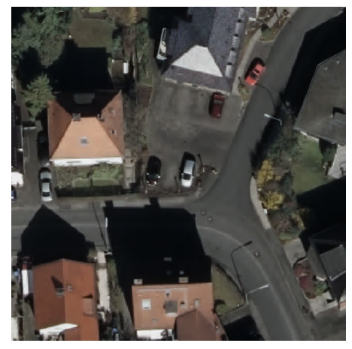
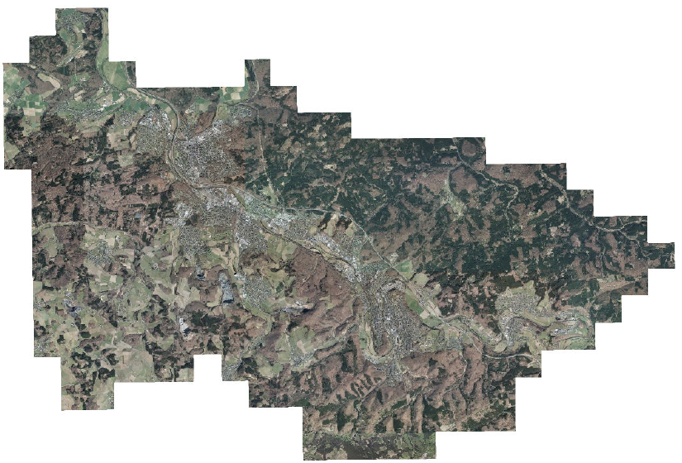
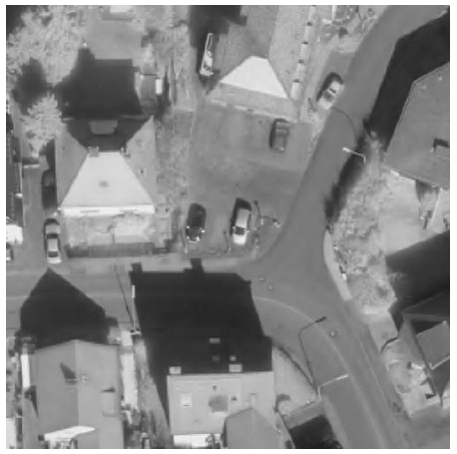
Digital Orthographic Photographs

Slide 16
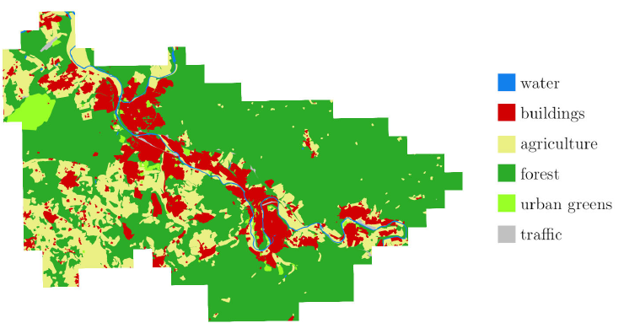
Vector Graphics with Land Use

Slide 17
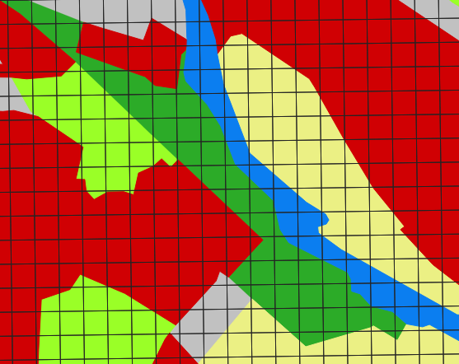
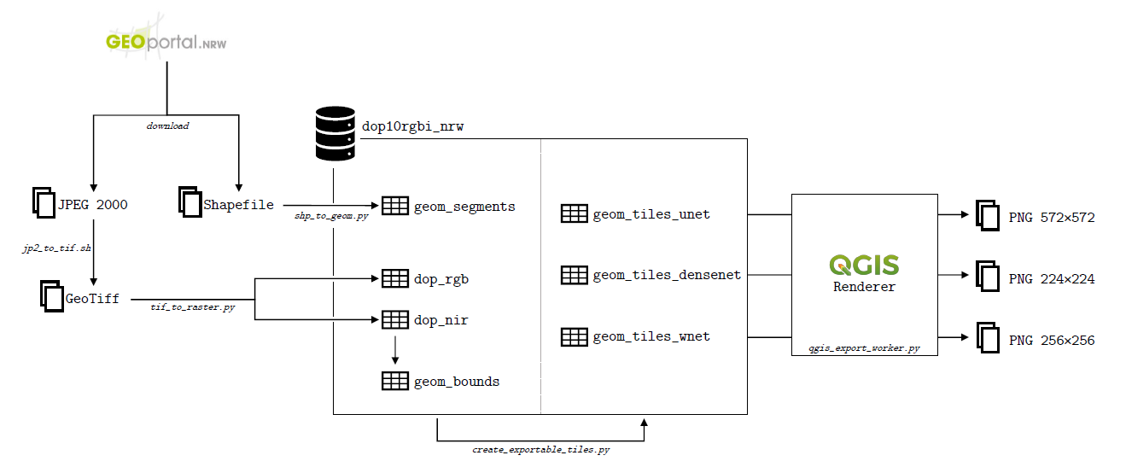
Preparations

Slide 18
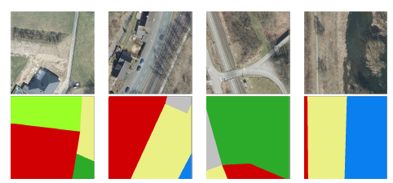
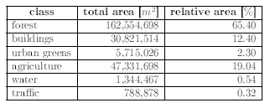
Considerations

Slide 19
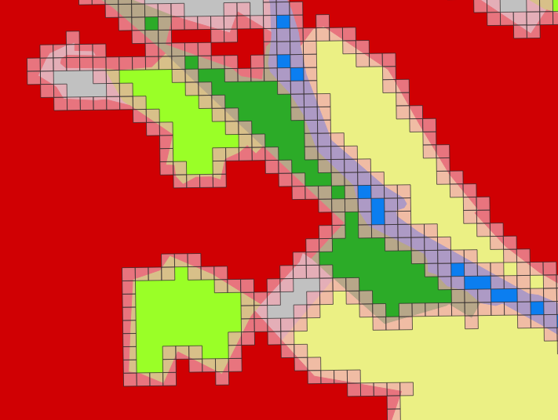
Class Imbalance
Many experiments with class weights -> no success

Slide 20
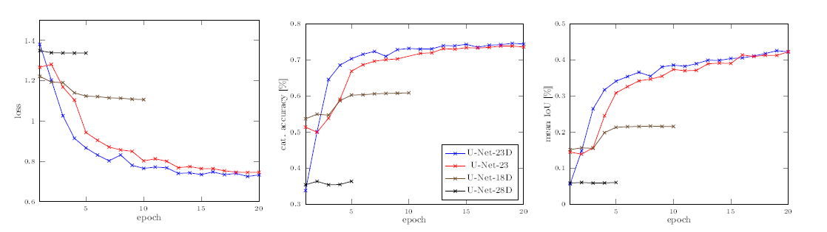
U-Net Experiments - Metrics
List configurations with variations and # of params

Slide 21
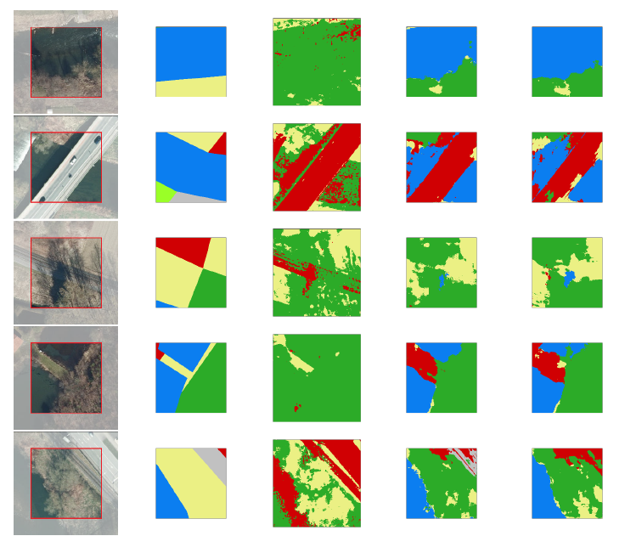
U-Net Experiments - Images

Slide 22
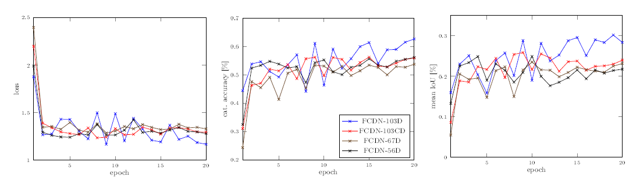
FC-DenseNet Experiments - Metrics
List configurations with variations and # of params

Slide 23
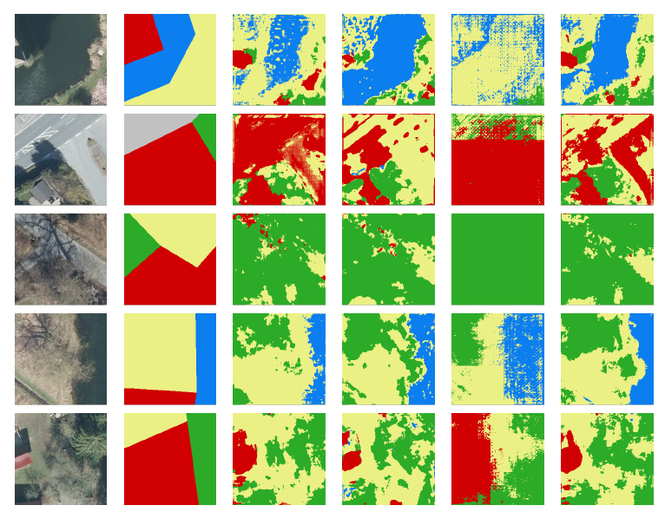
FC-DenseNet Experiments - Images

Slide 24
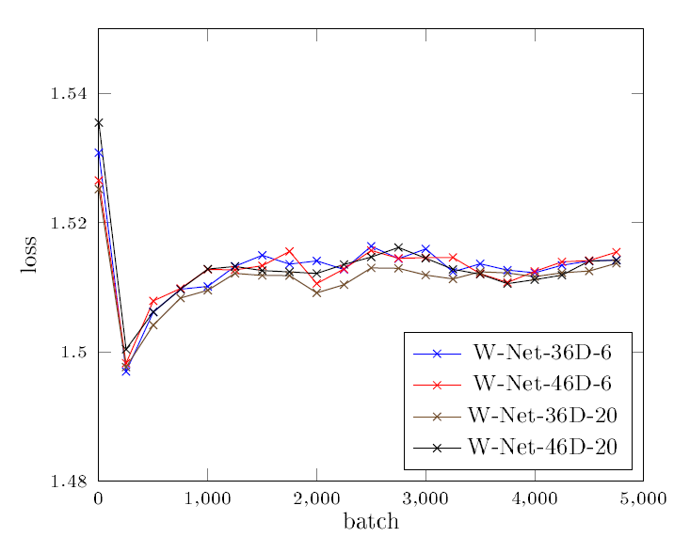
W-Net Experiments - Images
List configurations with variations and # of params

Slide 25
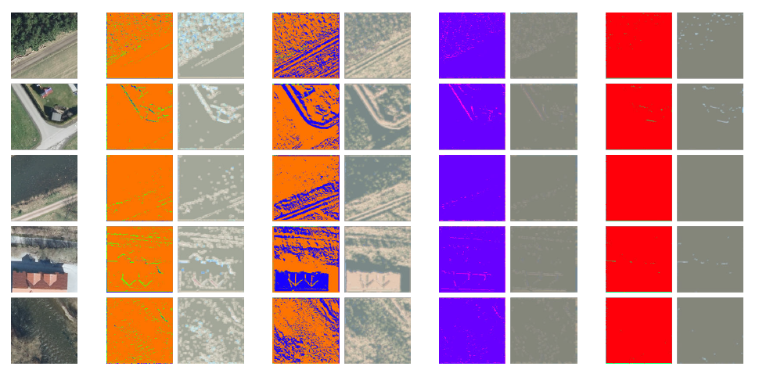
W-Net Experiments - Images

Slide 26
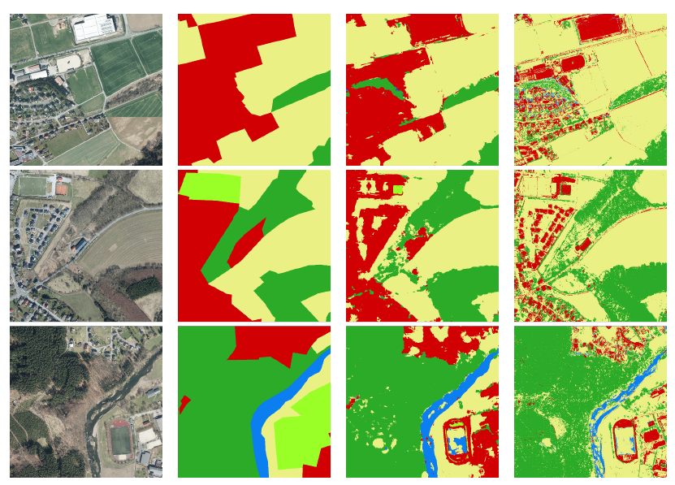
Larger Scale Images
Computation time?

Slide 27
Live Demo?
Show images, do live segmentation with U-Net and FC-DenseNet

Slide 28
Discussion

Slide 29
Vegetation Indices
Compares spectral bands of light

Slide 30
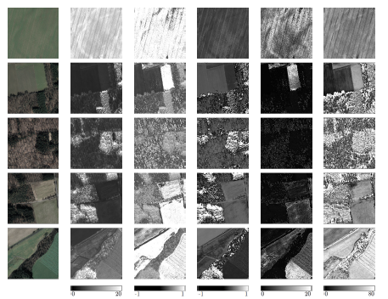
Ratio Vegetation Index

Slide 31
Normalized Difference Vegetation Index

Slide 32
Enhanced Vegetation Index

Slide 33
Soil-adjusted Vegetation Index

Slide 34
Modified soil-adjusted Vegetation Index?

Slide 35
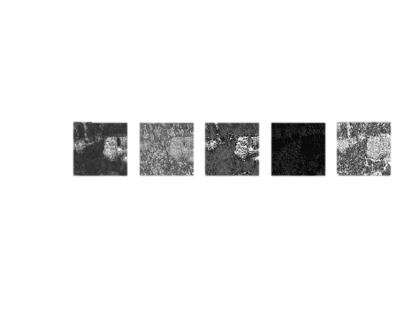
Discussion
Show different results, which one is correct?
Only green vegetation, no dead vegetation, no other obstacles
No information about height and robustness

Slide 36
Conclusion
Supervised learning was good, U-Net and FC-DenseNet can both be used, Further improvements possible
Desicion if rough or fine segmentations
Not more data, but more accurate labels, maybe other regions of world
Vegetation indices are OK, but not as standalone factor
No recommendation of which one to use, depending on sensor etc

